Slide 1

Cloud 101: Introduction to Commercial Cloud Computing
Notes:
https://www.youtube.com/watch?v=xcGHnGzDNrk

Slide 2
Introduction
Cloud Foundations Service – Research Computing – Office of Information Technology
Dylan Gottlieb (CU Boulder Research Computing Cloud Analyst)
www.rc.colorado.edu
rc-help@colorado.edu
Slides: https://github.com/ResearchComputing/cloud101_primer

Slide 3
Outline
What is the Cloud?
Services offered
Advantages of using the Cloud
Shared Responsibility Model
Example Use-Cases
Cost-Saving Considerations
Learning Materials
How to get started

Slide 4
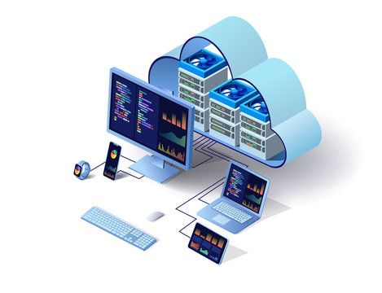
What is the Cloud?
"The cloud" refers to servers that are accessed via the Internet. This includes the Operating Systems, software, and databases that run on those servers.

Slide 5


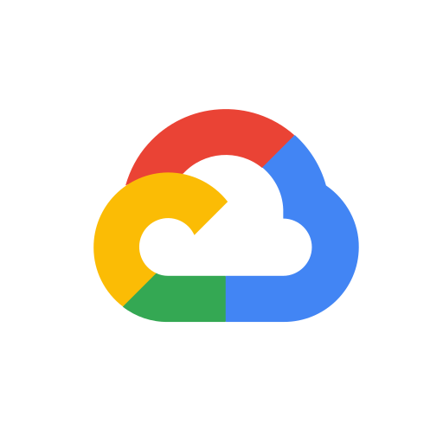

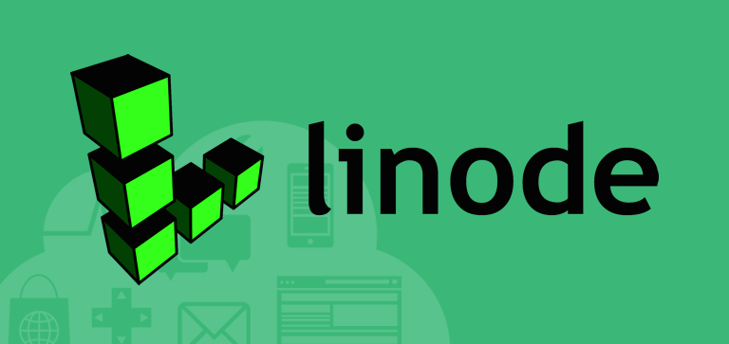
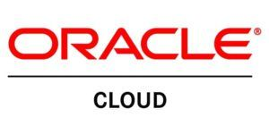
Commercial Cloud Providers
Amazon AWS
Microsoft Azure
Google Cloud Provider
Many more

Slide 6
What is the Cloud?
Anything as a Service (XaaS) – a business model (generally subscription based) in which something is provided to the customer as a service
Infrastructure as a Service (IaaS) - Raw IT resources offered to the user by the cloud service provider
Most control, most advanced setup
Examples: Servers, Networking
Platform as a Service (PaaS) – A platform that a provider offers to its customers via the internet
Some control, simplified setup
Examples : Windows Virtual Machine, MySQL Database
Software as a Service (SaaS) - Software that runs on a provider’s infrastructure
Least control, most simple setup
Examples : Jupyterhub, Wordpress Site

Slide 7
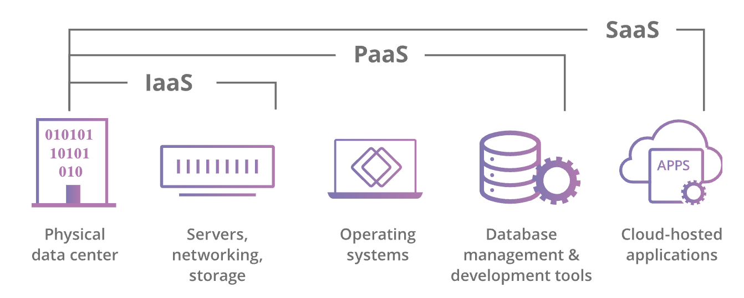
What is the Cloud?

Slide 8
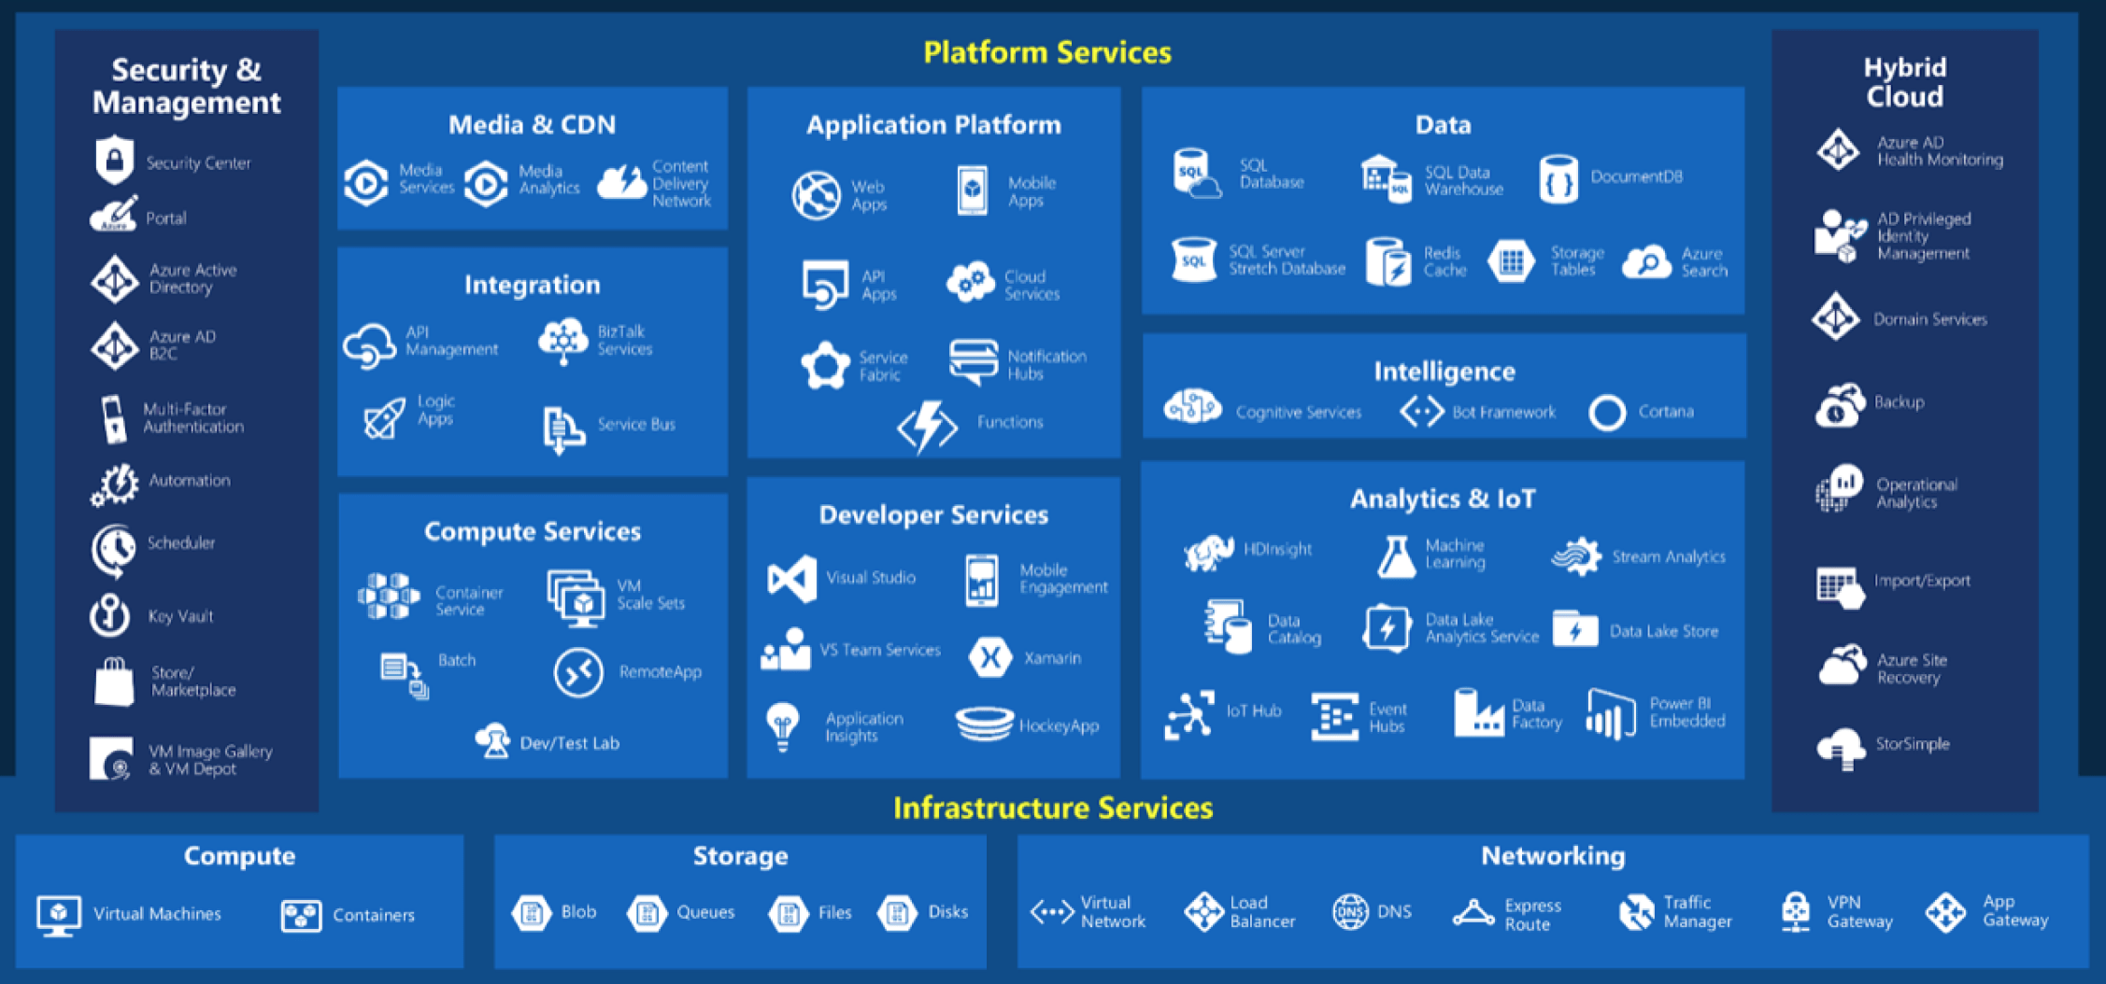
What services are offered?
Notes:
Amazon Web Services - (Host of cloud services)
A way to host your application or data on Amazon’s hardware

Slide 9
What tools are available?
Conventional Cloud Computing Resources
Virtual Machines
Storage
Databases
Quick Start Tools
Lightsail for Research

Slide 10
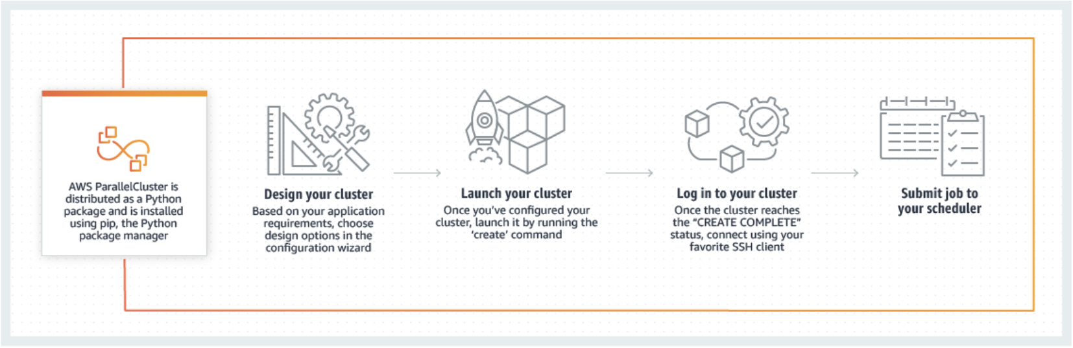
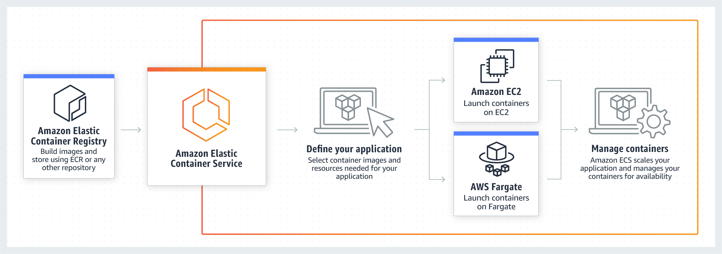
What tools are available?
Parallel Cluster
Advanced tools
Cluster Environments
Parallel cluster
CycleCloud
Container Services
Elastic Kubernetes Service
Elastic Container Service
Elastic Container Service

Slide 11
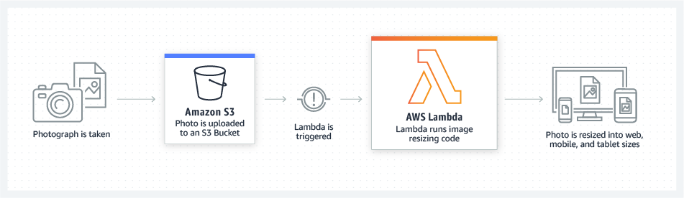
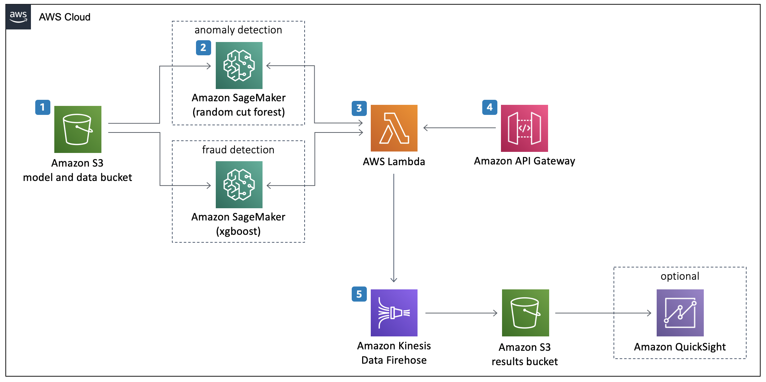
What tools are available?
Lambda
Advanced tools
Serverless code execution
Lambda
Machine Learning
Sagemaker, Rekognition, Polly, etc.
Sagemaker
Notes:
Lambda: Lambda natively supports Java, Go, PowerShell, Node.js, C#, Python, and Ruby code, and provides a Runtime API allowing you to use any additional programming languages to author your functions.

Slide 12
Why use the cloud?
Availability
Data durability
99.999999999% (11 9's) of data durability
"If you store 10,000 objects with us, on average we may lose one of them every 10 million years or so.” –Jeff Barr (AWS)
Quick and easy Scalability
Get closer to the data
Wide array of Computing Power
Cost
Alleviate operational burden
Notes:
Don’t have to manage infrastructure
High availability
Go into availability zones?
Data security
Go into the .9999% thing from AWS
Quick and easy Scalability
Getting closer to the data
NASA data sets in cloud
Running applications in the geographical zone that the data is in
Choice of computing power
High memory
High CPU
GPU
High speed storage
HCP, HTC
Pretty much anything you want
Cost Variablility
Can be cheaper than running on-premise in many cases due to not having to pay for staffing, utilities, etc.
We've found it can be cheaper in comparison to an on-premise system that is not fully utilized

Slide 13
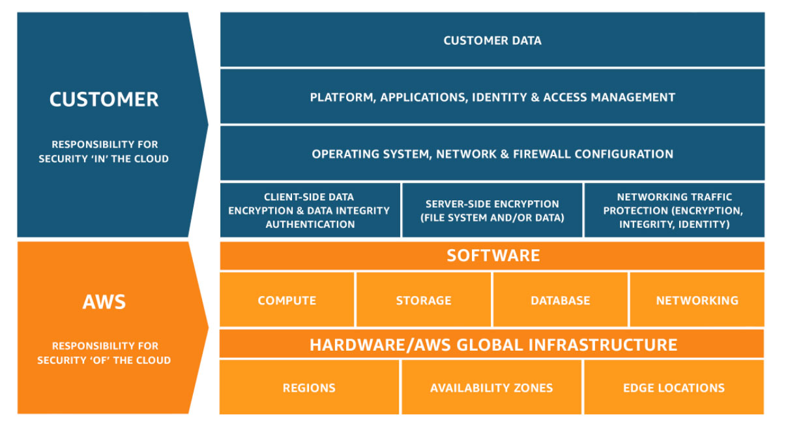
Shared Responsibility Model
Notes:
AWS removes the need to manage a datacenter

Slide 14
Example use-cases
Netflix
Using cloud to meet needs for expensive or otherwise unavailable resources (e.g., specialized GPUs, huge amounts of RAM)
Using cloud computing to be "near" huge bioinformatics or geophysical datasets that are impractical to download (because these huge datasets are often stored in the public cloud)
Running a persistent database that mines social media feeds for patterns/phrases
Teaching "hubs" such as Rstudio and Jupyter, which provide a common software environment for all students

Slide 15

What scares you about working in the cloud?

Slide 16
Cost-Saving Considerations
Budget Alerts and Actions – Alert when budget is reached and shutdown resources
Analyze Cost Data – Understand cost on a resource level
Spot Instances – Utilize cloud provider's unused resources at discount
Reserved Instances – Commitment to use VM for extended period at a discount
Autoscaling – Scale resources as demand grows
Utilizing serverless functions – 1 million requests/month free
Microservices - Separate monolithic applications into smaller pieces
Appropriate Storage Options – Utilize cold storage when applicable

Slide 17
Learning Materials
AWS Educate
Azure Learn
Google Cloud Training
AWS Events on Campus
Sign up for our newsletter

Slide 18
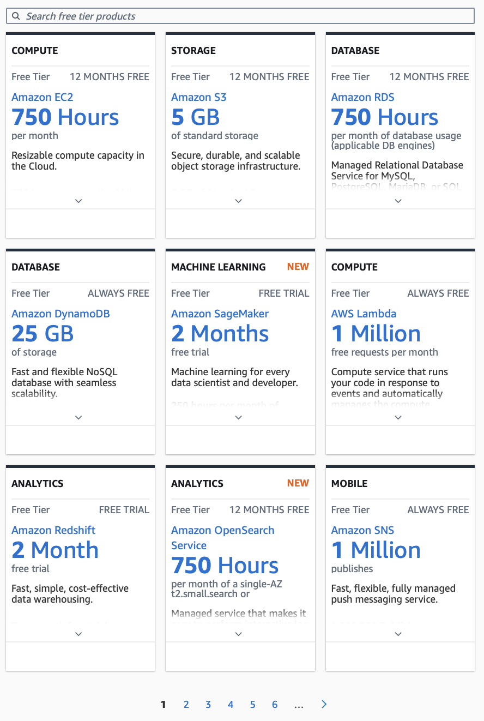
How to get started
Cloud Provider free trials
AWS Free Tier
Microsoft Free Tier
Google Free Tier
National Science Foundation – JetStream2
Available to all RMACC members eligible for an ACCESS account
Cloud Foundations Service
AWS, Azure, GCP access for CU affiliates
Notes:
We'll help to provision the resources you need, estimate costs for these resources.
We'll work with you on budgeting.

Slide 19
How can you use the cloud in your Project?

Slide 20

Thank you!
Questions?
Help Desk:
https://www.colorado.edu/rc/userservices/contact
Feedback:
https://forms.office.com/r/idtDVWz7HY

